Slide 1
Global Health Observatory
Analysis
Vikash Kumar
Don Wilson

Slide 2
Problem Statement
Health plays a vital role in deciding Life Expectancy. People all over the world pay a lot to insurance companies to secure the finance if there is a health emergency. It becomes very important to understand which factors directly or indirectly affect life expectancy.
What are the predicting variables actually affecting life expectancy?
Should a country having a lower life expectancy value(<65) increase its healthcare expenditure to improve its average lifespan?
How do Infant and Adult mortality rates affect life expectancy?
Does Life Expectancy have a positive or negative correlation with eating habits, lifestyle, exercise, smoking, drinking alcohol, etc?
What is the impact of schooling on the lifespan of humans?
Does Life Expectancy have a positive or negative relationship with drinking alcohol?
Do densely populated countries tend to have a lower life expectancy?
What is the impact of Immunization coverage on life Expectancy?

Slide 3
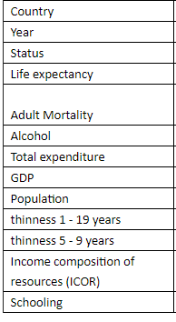
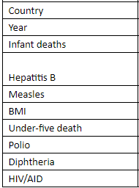
Data Set Overview
Unique key
COUNTRY DATA
Table showing the metrics of the country with important parameters.
IMMUNIZATION DATA
Table showing diseases, mortality, and immunization coverage factors of the country.

Slide 4
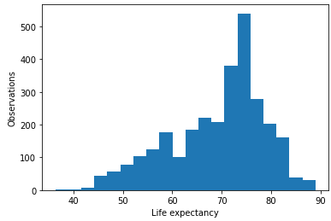
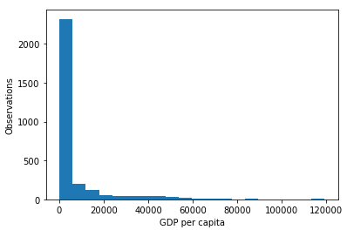
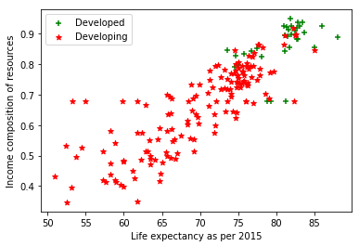
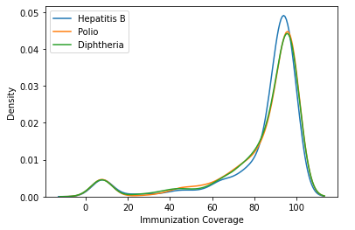
Overall Distribution of Performance Indicators
70-80 years is the most occurring Life expectancy
Lot of countries have very low GDP per capita
Life expectancy increases wrt ICOR in Developed and Developing Countries
Although Developed countries have ICOR and Life expectancy in higher range
Most of the countries have higher Immunization coverage for all diseases

Slide 5
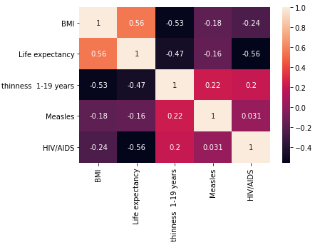
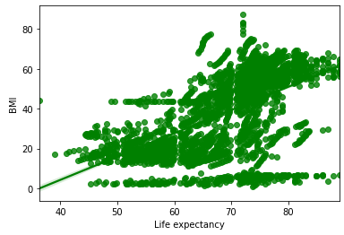
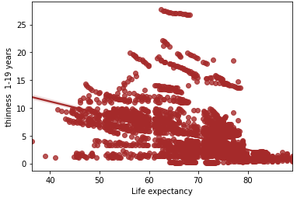
Correlated factors of Life Expectancy
No parameters have strong positive or strong negative correlation with Life expectancy
Maximum positive correlation with BMI: 0.56
Nearly 0.5 positive correlation with Thinness also
Maximum negative correlation with HIV/AIDS: -0.56
Positive & Negative Correlation with Life expectancy

Slide 6
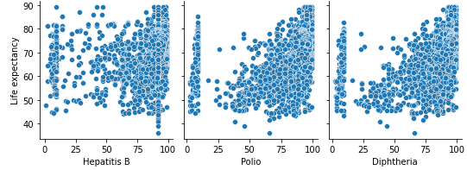

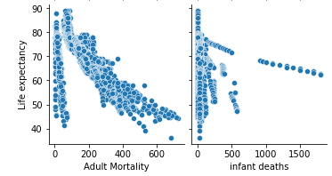

Effect of Immunization & Mortality on Life Expectancy
Immunization is causing positive
impact on Life expectancy
Polio & Diphtheria Immunization
has more impact on
Life expectancy compared to
Polio Immunization
Mortality Rate has negative
impact on Life expectancy
Adult Mortality Rate is having
a very high correlation of 0.7
on Life expectancy

Slide 7
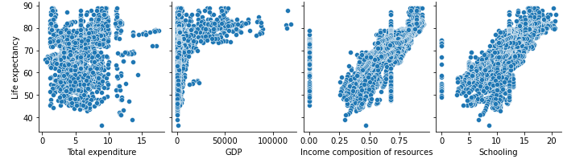
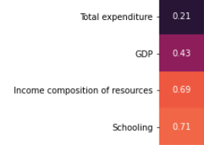
Effect of Socio-Economic factors on Life Expectancy
Life expectancy tends to increase with economic condition of the country
HDI in terms of Income composition of resources is the most impacting economic factor on Life Expectancy
Schooling has the highest positive impact on Life Expectancy

Slide 8
Let’s compare Life expectancy with different factors by developed and developing
countries.

Slide 9
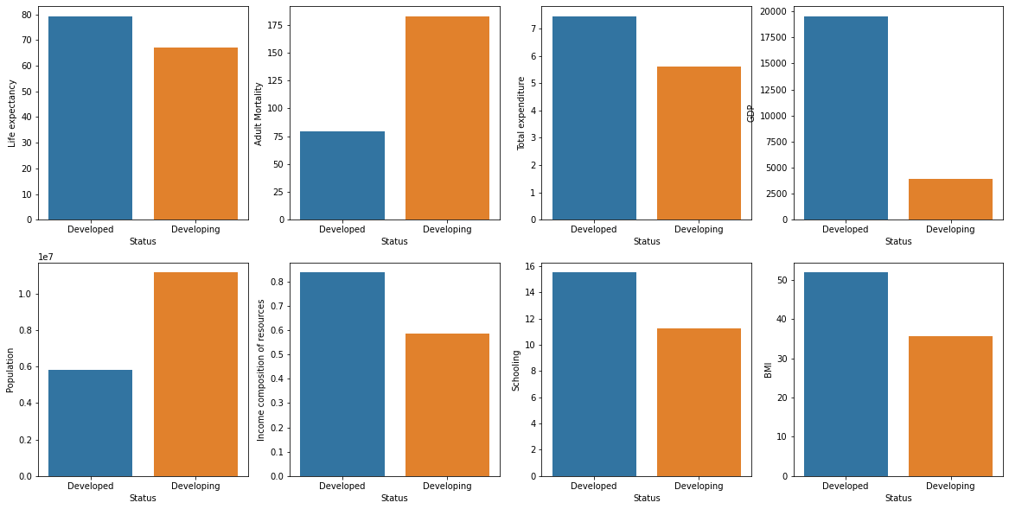

Slide 10
Now take India, the United States of America, China, the Central African Republic, Bhutan to compare by different variable wrt
Life expectancy.

Slide 11
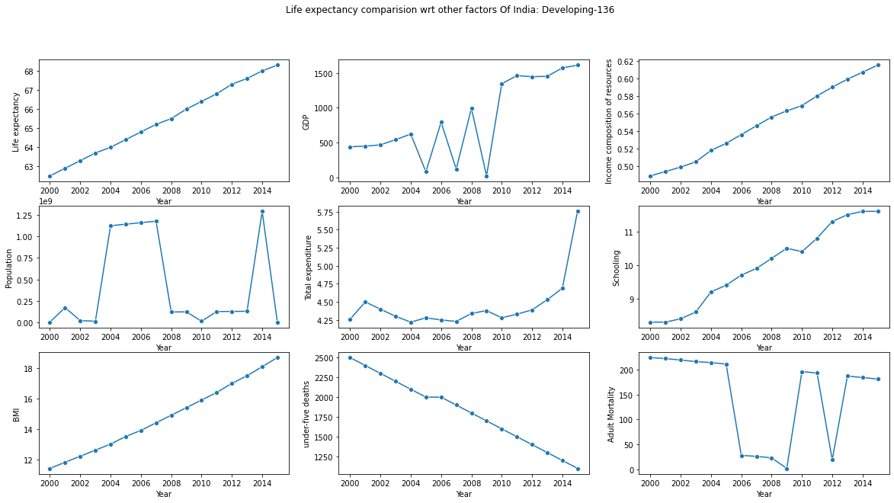

Slide 12
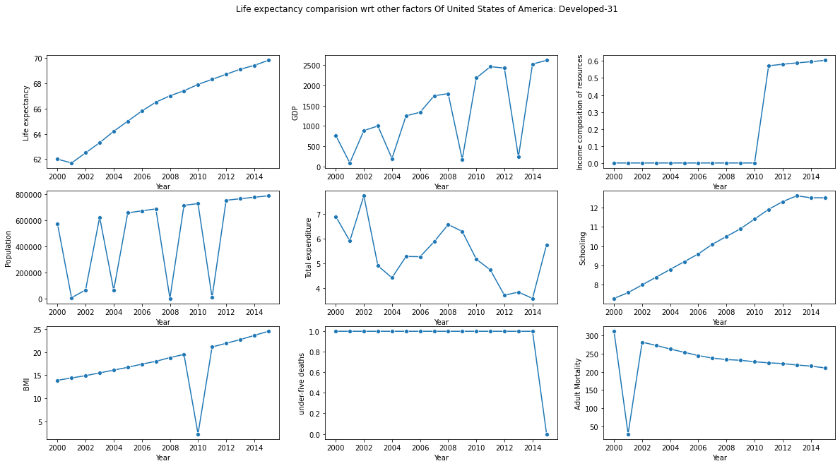

Slide 13
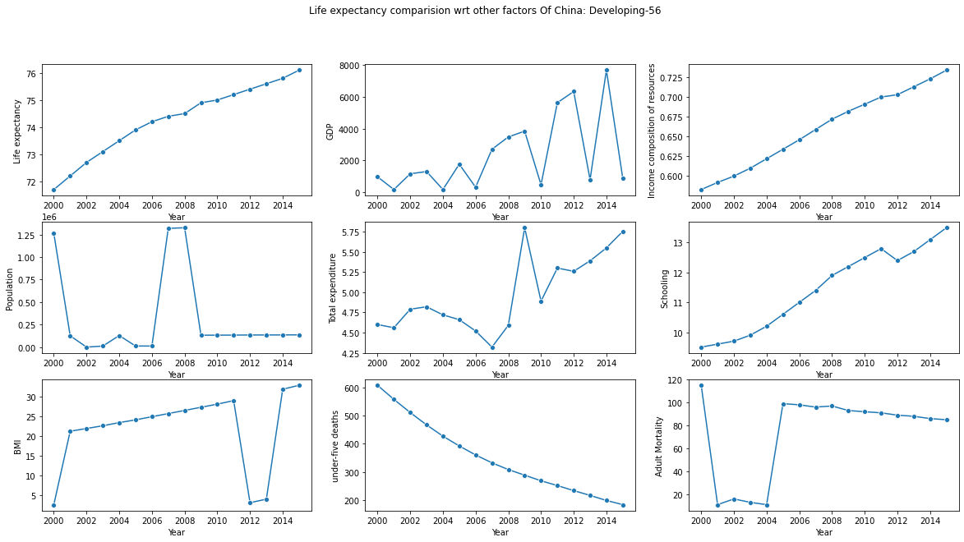

Slide 14
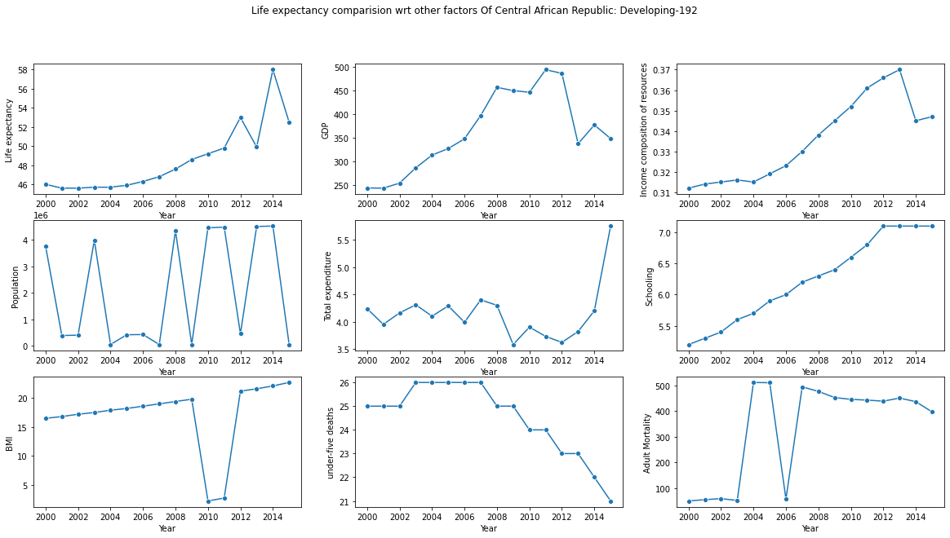

Slide 15
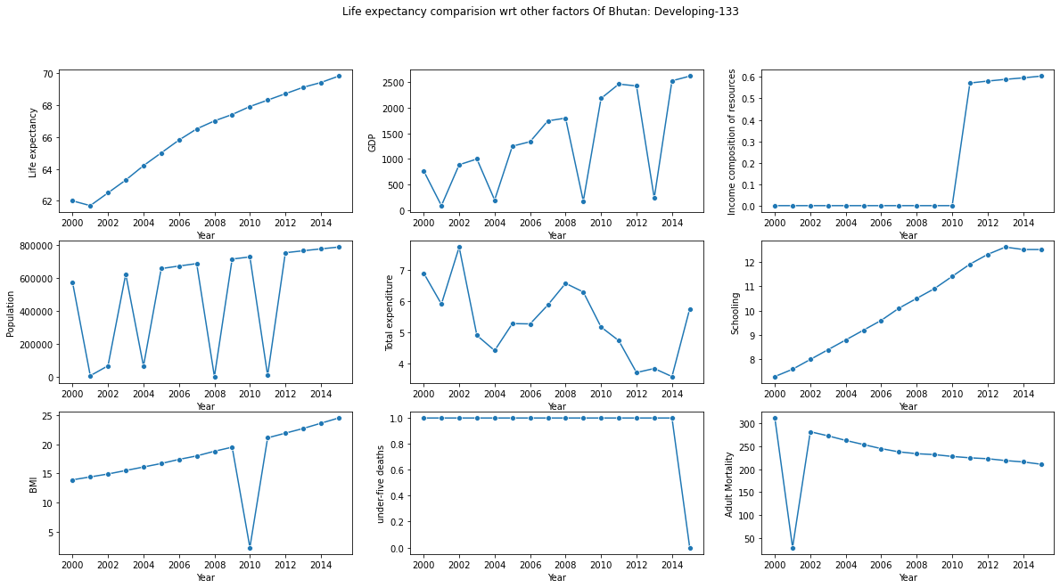

Slide 16
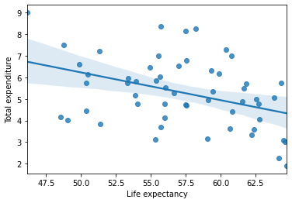
Should a country having a lower life expectancy value(<65) increase its healthcare expenditure to improve its average lifespan?
NO
For some country even if they have higher total expenditure, they have low life expectancy.

Slide 17
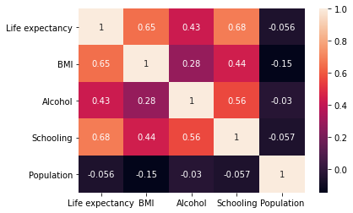
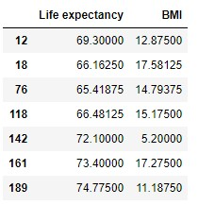
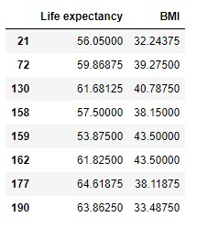
Does Life Expectancy have a positive or negative correlation with eating habits(BMI), lifestyle, exercise, smoking, drinking alcohol, etc?
Do densely populated countries tend to have a lower life expectancy?
BMI | Weight Status
Below 18.5 | Underweight
18.5 – 24.9 | Normal or Healthy Weight
25.0 – 29.9 | Overweight
30.0 and Above | Obese

Slide 18
Conclusion
No parameters have strong positive or strong negative correlation with Life expectancy except Schooling.
Countries which have higher Immunization coverage have higher life expectancy.
Life expectancy tends to increase with economic condition of the country
Life expectancy is high in developed countries, so mortality rate is low, this might be due to cause of higher total expenditure, GDP Schooling and lower population in developed countries.
Total expenditure on health have not much impact on live expectancy.
BMI also does not have much impact on life expectancy.
some Densely populated countries might have lower life expectancy.

Slide 19
Thank You

